Slide 1
Software Engineering Software Processes Lect 02

Slide 2
Topics covered
Software process activities
Software process models
Waterfall
Iterative
Incremental
Spiral
Agile
XP
SCRUM

Slide 3
The software process
A structured set of activities required to develop a software system.
Many different software processes but all involve:
Specification – defining what the system should do;
Design and implementation – defining the organization of the system and implementing the system;
Validation – checking that it does what the customer wants;
Evolution – changing the system in response to changing customer needs.
A software process model is an abstract representation of a process. It presents a description of a process from some particular perspective.

Slide 4
Software process descriptions
When we describe and discuss processes, we usually talk about the activities in these processes such as specifying a data model, designing a user interface, etc. and the ordering of these activities.
Process descriptions may also include:
Products, which are the outcomes of a process activity;
Roles, which reflect the responsibilities of the people involved in the process;
Pre- and post-conditions, which are statements that are true before and after a process activity has been enacted or a product produced.

Slide 5
Plan-driven and agile processes
Plan-driven processes are processes where all of the process activities are planned in advance and progress is measured against this plan.
In agile processes, planning is incremental and it is easier to change the process to reflect changing customer requirements.
In practice, most practical processes include elements of both plan-driven and agile approaches.
There are no right or wrong software processes.

Slide 6
Process activities

Slide 7
Process activities
Real software processes are inter-leaved sequences of technical, collaborative and managerial activities with the overall goal of specifying, designing, implementing and testing a software system.
The four basic process activities of specification, development, validation and evolution are organized differently in different development processes.
For example, in the waterfall model, they are organized in sequence, whereas in incremental development they are interleaved.

Slide 8
The requirements engineering process
Notes:
In requirements engineering, requirements elicitation is the practice of researching and discovering the requirements of a system from users, customers, and other stakeholders. The practice is also sometimes referred to as "requirement gathering".

Slide 9
Software specification
The process of establishing what services are required and the constraints on the system’s operation and development.
Requirements engineering process
Requirements elicitation and analysis
What do the system stakeholders require or expect from the system?
Requirements specification
Defining the requirements in detail
Requirements validation
Checking the validity of the requirements

Slide 10
Software design and implementation
The process of converting the system specification into an executable system.
Software design
Design a software structure that realises the specification;
Implementation
Translate this structure into an executable program;
The activities of design and implementation are closely related and may be inter-leaved.

Slide 11
A general model of the design process

Slide 12
Design activities
Architectural design, where you identify the overall structure of the system, the principal components (subsystems or modules), their relationships and how they are distributed.
Database design, where you design the system data structures and how these are to be represented in a database.
Interface design, where you define the interfaces between system components.
Component selection and design, where you search for reusable components. If unavailable, you design how it will operate.

Slide 13
System implementation
The software is implemented either by developing a program or programs or by configuring an application system.
Design and implementation are interleaved activities for most types of software system.
Programming is an individual activity with no standard process.
Debugging is the activity of finding program faults and correcting these faults.

Slide 14
Software validation
Verification and validation (V & V) is intended to show that a system conforms to its specification and meets the requirements of the system customer.
Involves checking and review processes and system testing.
System testing involves executing the system with test cases that are derived from the specification of the real data to be processed by the system.
Testing is the most commonly used V & V activity.

Slide 15
Stages of testing

Slide 16
Testing stages
Component testing
Individual components are tested independently;
Components may be functions or objects or coherent groupings of these entities.
System testing
Testing of the system as a whole. Testing of emergent properties is particularly important.
Customer testing
Testing with customer data to check that the system meets the customer’s needs.

Slide 17
Testing phases in a plan-driven software process (V-model)

Slide 18
Software evolution
Software is inherently flexible and can change.
As requirements change through changing business circumstances, the software that supports the business must also evolve and change.
Although there has been a demarcation between development and evolution (maintenance) this is increasingly irrelevant as fewer and fewer systems are completely new.

Slide 19
System evolution

Slide 20
Software process models

Slide 21
Software process models
The waterfall model
Plan-driven model. Separate and distinct phases of specification and development.
Incremental development
Specification, development and validation are interleaved. May be plan-driven or agile.
Integration and configuration
The system is assembled from existing configurable components. May be plan-driven or agile.
In practice, most large systems are developed using a process that incorporates elements from all of these models.

Slide 22
Notes:
Waterfall model: SE and Testing by Agarwal et al.

Slide 23
The waterfall model

Slide 24
Waterfall model phases
There are separate identified phases in the waterfall model:
Requirements analysis and definition
System and software design
Implementation and unit testing
Integration and system testing
Operation and maintenance
The main drawback of the waterfall model is the difficulty of accommodating change after the process is underway. In principle, a phase has to be complete before moving onto the next phase.

Slide 25
Waterfall model problems
Inflexible partitioning of the project into distinct stages makes it difficult to respond to changing customer requirements.
Therefore, this model is only appropriate when the requirements are well-understood and changes will be fairly limited during the design process.
Few business systems have stable requirements.
The waterfall model is mostly used for large systems engineering projects where a system is developed at several sites.
In those circumstances, the plan-driven nature of the waterfall model helps coordinate the work.

Slide 26
Notes:
SE &Testing by Agarwal et al.

Slide 27
Notes:
SE &Testing by Agarwal et al.

Slide 28
Class task :
Why do you think follows WATERFALL ?

Slide 29
Incremental Model

Slide 30
Incremental development
Notes:
According to the incremental model, the software is divided into separate modules(components)and each of these modules has a separate set of waterfall activities including requirements gathering and analysis, design, implementation, deployment, and maintenance.
When any component is ready, then the component is delivered to the customer and when remaining components become ready than delivered to the customer one by one by integrating new components with old once.
Suppose we want to develop a web-based social network with the following functionalities;
The user should signup for the system.
The user should log into the system and can send or accept the friend request.
How can use the incremental model in this scenario;
https://t4tutorials.com/incremental-model-in-software-engineering-advantages-disadvantages-examples-case-study-of-incremental-model/

Slide 31
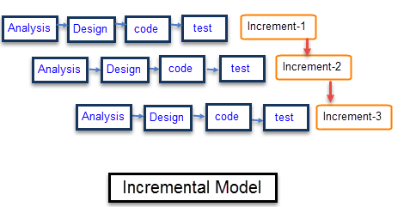

Slide 32
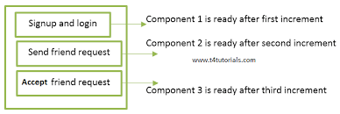
Example: Incremental Model

Slide 33
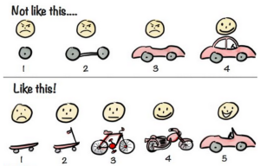
Incremental Software development - Example Comparison with Iterative development

Slide 34
When to use Incremental Model
Requirements of the system are clearly understood
When demand for an early release of a product arises
When software engineering team are not very well skilled or trained
When high-risk features and goals are involved
Such methodology is more in use for web application and product based companies

Slide 35
Incremental development benefits
The cost of accommodating changing customer requirements is reduced.
The amount of analysis and documentation that has to be redone is much less than is required with the waterfall model.
It is easier to get customer feedback on the development work that has been done.
Customers can comment on demonstrations of the software and see how much has been implemented.
More rapid delivery and deployment of useful software to the customer is possible.
Customers are able to use and gain value from the software earlier than is possible with a waterfall process.
Notes:
As sequential phases need to be functional hence the cost is higher as compared to that of WaterFall Model also the complexity is more than WaterFall.
On other hand in WaterFall Model due to linear development only one phase of development is operational and hence cost and complexity is low as compared to that of Incremental Model.

Slide 36
Incremental development problems
The process is not visible.
Managers need regular deliverables to measure progress. If systems are developed quickly, it is not cost-effective to produce documents that reflect every version of the system.
System structure tends to degrade as new increments are added.
Unless time and money is spent on refactoring to improve the software, regular change tends to corrupt its structure. Incorporating further software changes becomes increasingly difficult and costly.

Slide 37
Incremental development and delivery
Incremental development
Develop the system in increments and evaluate each increment before proceeding to the development of the next increment;
Normal approach used in agile methods;
Evaluation done by user/customer proxy.
Incremental delivery
Deploy an increment for use by end-users;
More realistic evaluation about practical use of software;
Difficult to implement for replacement systems as increments have less functionality than the system being replaced.

Slide 38
Incremental delivery

Slide 39
Incremental delivery
Rather than deliver the system as a single delivery, the development and delivery is broken down into increments with each increment delivering part of the required functionality.
User requirements are prioritised and the highest priority requirements are included in early increments.
Once the development of an increment is started, the requirements are frozen though requirements for later increments can continue to evolve.

Slide 40
Incremental delivery advantages
Customer value can be delivered with each increment so system functionality is available earlier.
Early increments act as a prototype to help elicit requirements for later increments.
Lower risk of overall project failure.
The highest priority system services tend to receive the most testing.

Slide 41
Incremental delivery problems
Most systems require a set of basic facilities that are used by different parts of the system.
As requirements are not defined in detail until an increment is to be implemented, it can be hard to identify common facilities that are needed by all increments.
The essence of iterative processes is that the specification is developed in conjunction with the software.
However, this conflicts with the procurement model of many organizations, where the complete system specification is part of the system development contract.

Slide 42
Software Prototyping

Slide 43
Software prototyping
A prototype is an initial version of a system used to demonstrate concepts and try out design options.
A prototype can be used in:
The requirements engineering process to help with requirements elicitation and validation;
In design processes to explore options and develop a UI design;
In the testing process to run back-to-back tests.

Slide 44
Notes:
Agarwal et al.

Slide 45
Benefits of prototyping
Improved system usability.
A closer match to users’ real needs.
Improved design quality.
Improved maintainability.
Reduced development effort.

Slide 46
The process of prototype development

Slide 47
Prototype development
May be based on rapid prototyping languages or tools
May involve leaving out functionality
Prototype should focus on areas of the product that are not well-understood;
Error checking and recovery may not be included in the prototype;
Focus on functional rather than non-functional requirements such as reliability and security

Slide 48
Throw-away prototypes
Prototypes should be discarded after development as they are not a good basis for a production system:
It may be impossible to tune the system to meet non-functional requirements;
Prototypes are normally undocumented;
The prototype structure is usually degraded through rapid change;
The prototype probably will not meet normal organisational quality standards.

Slide 49
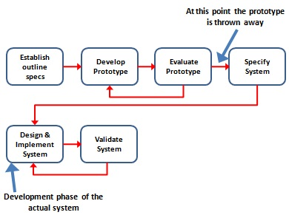

Slide 50
Controlling changes with prototyping
Notes:
Agarwal et al.

Slide 51
Spiral Model

Slide 52
Boehm’s spiral model
Process is represented as a spiral rather than as a sequence of activities with backtracking.
Each loop in the spiral represents a phase in the process.
No fixed phases such as specification or design - loops in the spiral are chosen depending on what is required.
Risks are explicitly assessed and resolved throughout the process.

Slide 53
An Evolutionary (Spiral) Model
Notes:
53

Slide 54
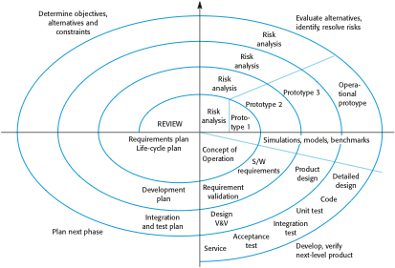
Boehm’s spiral model of the software process

Slide 55
Spiral model sectors
Objective setting
Specific objectives for the phase are identified.
Risk assessment and reduction
Risks are assessed and activities put in place to reduce the key risks.
Development and validation
A development model for the system is chosen which can be any of the generic models.
Planning
The project is reviewed and the next phase of the spiral is planned.

Slide 56
Spiral model usage
Spiral model has been very influential in helping people think about iteration in software processes and introducing the risk-driven approach to development.
In practice, however, the model is rarely used:
Can be a costly model to use
Risk analysis requires highly specific expertise.
Doesn’t work well for smaller projects.

Slide 57
RAD Model

Slide 58
RAD Model

Slide 59
Benefits of RAD
Rapid application development (RAD) is a linear sequential S/W development process model that emphasizes on extremely short development cycle.
high-speed RAD is achieved by using a component-based project construction approach.
If requirements are well understood and project scope is constrained (i.e. goals/ are fixed / freezed); the RAD enables a development team to create a “fully functional system” within very short time (e.g. 60-90 days).
Notes:
59
59

Slide 60
RAD Phases
1. Business Modeling (Business Processes)
Information flows among business functions is modeled such that answers the questions:
What information is generated?
Who generates it?
Who processes it?
Where does the information go?
2. Data Modeling (Entities)
(1) The information flow is refined into a set of data objects that are needed to support the business.
(2) Characteristics (attributes) of each object are identified and
(3) Relationships between these objects are defined.
Notes:
60
60
A business model describes the rationale of how an organization creates, delivers, and captures value^{[1]} - economic, social, or other forms of value. The term business model is thus used for a broad range of informal and formal descriptions to represent core aspects of a business, including purpose, offerings, strategies, infrastructure, organizational structures, trading practices, and operational processes and policies.
Business process
A business process is a collection of related, structured activities or tasks that produce a specific service or product (serve a particular goal) for a particular customer or customers
Data modeling is a method used to define and analyze data requirements needed to support the business processes of an organization. The data requirements are recorded as a conceptual data model with associated data definitions. Actual implementation of the conceptual model is called a logical data model. To implement one conceptual data model may require multiple logical data models. Data modeling defines not just data elements, but their structures and relationships between them ^{[2]} Data modeling techniques and methodologies are used to model data in a standard, consistent, predictable manner in order to manage it as a resource. The use of data modeling standards is strongly recommended for all projects requiring a standard means of defining and analyzing data within an organization, eg using data modeling:
to manage data as a resource;
for the integration of information systems;
for designing databases/data warehouses (aka data repositories)
Data models support data and computer systems by providing the definition and format of data. If this is done consistently across systems then compatibility of data can be achieved. If the same data structures are used to store and access data then different applications can share data. The results of this are indicated above. However, systems and interfaces often cost more than they should, to build, operate, and maintain. They may also constrain the business rather than support it. A major cause is that the quality of the data models implemented in systems and interfaces is poor.^{[1]}
Business rules, specific to how things are done in a particular place, are often fixed in the structure of a data model. This means that small changes in the way business is conducted lead to large changes in computer systems and interfaces.
Entity types are often not identified, or incorrectly identified. This can lead to replication of data, data structure, and functionality, together with the attendant costs of that duplication in development and maintenance.
Data models for different systems are arbitrarily different. The result of this is that complex interfaces are required between systems that share data. These interfaces can account for between 25-70% of the cost of current systems.
Data cannot be shared electronically with customers and suppliers, because the structure and meaning of data has not been standardised. For example, engineering design data and drawings for process plant are still sometimes exchanged on paper.
Data modeling is a way to structure and organize data so it can be used easily by databases. Unstructured data can be found in word processing documents, email messages, audio or video files, and design programs. Data modeling doesn't want these "ugly" data; rather, data modeling wants data that is all made up in a nice, neat package for processing by a database. So in a way, data modeling is concerned with how the data looks.

Slide 61
RAD Phases (2)
3. Process modeling (Processes/Functions)
(1) The data object defined in the data modeling phase are transformed to achieve the information flow necessary to implement a business function (i.e. transformation of input-object to output object defines flow of information in a process/function)
(2) Such processing descriptions are created for adding, modifying, deleting, or retrieving a data object.
4. Application Generation
(1) RAD process works to re-use existing components (when possible).
(2) Create re-useable components (when necessary). In all cases automated tools are used to facilitate construction of S/W.
61
Notes:
61
61
Process models are processes of the same nature that are classified together into a model. Thus, a process model is a description of a process at the type level. Since the process model is at the type level, a process is an instantiation of it. The same process model is used repeatedly for the development of many applications and thus, has many instantiations. One possible use of a process model is to prescribe how things must/should/could be done in contrast to the process itself which is really what happens. A process model is roughly an anticipation of what the process will look like. What the process shall be will be determined during actual system development.^{[2]}
The goals of a process model are to be:
Descriptive
Track what actually happens during a process.
Takes the point of view of an external observer who looks at the way a process has been performed and determines the improvements that have to be made to make it perform more effectively or efficiently.
Prescriptive
Defines the desired processes and how they should/could/might be performed.
Lays down rules, guidelines, and behavior patterns which, if followed, would lead to the desired process performance. They can range from strict enforcement to flexible guidance.
Explanatory
Provides explanations about the rationale of processes.
Explore and evaluate the several possible courses of action based on rational arguments.
Establish an explicit link between processes and the requirements that the model needs to fulfill.
Pre-defines points at which data can be extracted for reporting purposes.
SQL; Focus, Metafont, PostScript, S, IDL-PV, WAVE, Gauss, Mathematica,

Slide 62
RAD Phases (3)
5. Testing and Turnover
(1) Re-use releases from testing, as such components, are already tested.
(2) New components must be tested and all interfaces must be fully exercised. Optimally,
(3) If a business application can be modularized such that each major function can be completed in less than 3 months time, each can be addressed by a separate RAD team, and then integrated (to give working system in 3-6 months)
Drawbacks
(1) For large scalable projects, RAD requires sufficient human resources to create right number of RAD teams.
RAD requires developers & customers committed to complete a system in a short time frame, other wise if commitment is lacking from either side, RAD projects will fail.
Notes:
62
62
Turnover> Result, yield
large, but scalable?? projects, RAD requires

Slide 63
RUP

Slide 64
Rational Unified Process
The Rational Unified Process (RUP) is an iterative software development process framework created by the Rational Software Corporation, a division of IBM since 2003
Process phases
Inception
Elaboration
Construction
Transaction
Notes:
Well defined and well documented process is important in project success. Its goal is to ensure the production of high-quality software that meets the needs of its end-users, within a predictable schedule and budget. Aimed at guiding software development organizations in their endeavors
It define roles. It describes the work that each role performs in activities. These activities operate on concrete artifacts: models, code, documents, and reports. Guidelines to perform certain activity with given tool. All of these process definition elements are organized into disciplines. RUP defines Nine disciplines, More than forty roles, Hundred artifacts, More than a thousand guidance pages. Process "plug-ins" adds even more functionality. RUP is heavy weight ?
Like any software product and is integrated with Rational suits of software development. Rational developers team continuously work to update (twice/year) the RUP, so it is never obsolete. All team members uses same version of process. Delivered online using web technology. In electronic form so can be tailored

Slide 65
Inception Phase
Overriding goal is obtaining buy-in from all interested parties
Initial requirements capture
Cost Benefit Analysis
Initial Risk Analysis
Project scope definition
Defining a candidate architecture
Development of a disposable prototype
Initial Use Case Model (10% - 20% complete)
First pass at a Domain Model

Slide 66
Elaboration Phase
Requirements Analysis and Capture
Use Case Analysis
Use Case (80% written and reviewed by end of phase)
Use Case Model (80% done)
Scenarios
Sequence and Collaboration Diagrams
Class, Activity, Component, State Diagrams
Glossary (so users and developers can speak common vocabulary)
Domain Model
to understand the problem: the system’s requirements as they exist within the context of the problem domain
Risk Assessment Plan revised
Architecture Document

Slide 67
Construction Phase
Focus is on implementation of the design:
cumulative increase in functionality
greater depth of implementation (stubs fleshed out)
greater stability begins to appear
implement all details, not only those of central architectural value

Slide 68
Transition Phase
The transition phase consists of the transfer of the system to the user community
It includes shipping, installation, training, technical support and maintenance
Development team begins to shrink
Control is moved to maintenance team
Alpha, Beta, and final releases
Software updates
Integration with existing systems (legacy, existing versions, etc.)

Slide 69
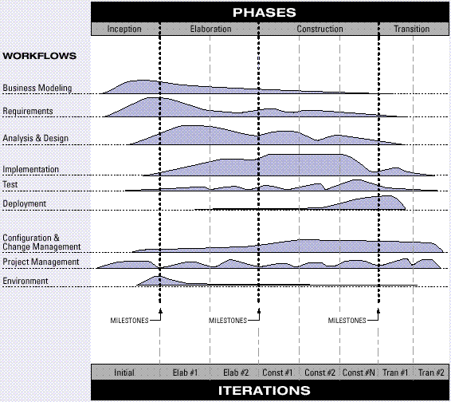
The Architecture of RUP

Slide 70
Agile Development

Slide 71
Agile Development
2001: Kent Beck and 16 other software developers, referred to as “Agile Alliance”, signed the “manifesto for Agile software development”. It stated:
We are uncovering better ways of developing software by doing it and helping others do it. Through this work we have come to value:
Individuals and interaction over processes and tool
Working software over comprehensive documentation
Customer collaboration over contract negotiation
Responding to change over following plan
That is, while there is value in the items on the right , we value the items on the left more.

Slide 72
Agile Principles
Agile Alliance defined 12 agility principles:
Highest priority is to satisfy the customer through early and continues delivery of valuable software.
Welcome changing requirements even late in the development (for customers competitive advantage).
Deliver working software frequently, from couple of weeks to couple of months.
Business people and developers must work together daily throughout the project.
Build project around motivated Individuals. Give them the environment and support they need, and trust them to get the job done.
Most efficient and effective method of conveying information to and with team is face-to-face conversation.

Slide 73
Agile Principles
Working software is the primary measure of progress.
Agile processes promote sustainable development. The sponsors, developers, and users should be able to maintain a constant pace.
Continuous attention to technical excellence and good design enhances agility.
Simplicity--the art of maximizing the amount of work not done--is essential.
The best architectures, requirements, and designs emerge from self-organizing teams.
At regular intervals, the team reflects on how to become more effective, then tunes and adjusts its behavior accordingly.

Slide 74
Agile Methods
Agile software development is a group of software development methodologies that are based on similar principles.
Agile methodologies generally promote a project management process that encourages
frequent inspection and adaptation
a leadership philosophy that encourages team work
a set of engineering best practices that allow for rapid delivery of high-quality software, and a business approach that aligns development with customer needs and company goals

Slide 75
What are Agile Methods?
Agile software development is a conceptual framework for undertaking software engineering projects.
Most agile methods attempt to minimize risk by developing software in short timeboxes, called iterations, which may typically last one to four weeks.
Each iteration is like a miniature software project of its own, and includes all of the tasks necessary to release the mini-increment of new functionality.
Notes:
Timeboxing is a time management technique common in planning projects (typically for software development), where the schedule is divided into a number of separate time periods (timeboxes, normally two to six weeks long), with each part having its own deliverables, deadline and budget. Timeboxing is a core aspect of rapid application development (RAD) software development processes, such as dynamic systems development method (DSDM) and agile software development techniques.
Timeboxes are used as a form of risk management for tasks that easily run over their deadlines. The end date is set in stone and may not be changed. If the team exceeds the date, the work is considered a failure and is cancelled or rescheduled. Some timebox methods allow the team to adjust the scope of the task in order to meet the deadline.

Slide 76
Agile Methods v/s Traditional Methods
Agile methods emphasize realtime communication, preferably face-to-face, over written documents.
Agile methods like XP relies on the close collaboration of actively engaged individuals with ordinary talents and has the ability to flexibly schedule the implementation of functionality, responding to changing business needs.
Reference: Extreme Programming explained: Embrace Change By: Kent Beck with Cynthia Andres; 2nd ed., 2005

Slide 77
Agile variants
Extreme Programming (XP)
Scrum
Adaptive Software Development (ASD)
Crystal Clear and Other Crystal Methodologies
Dynamic Systems Development Method (DSDM)
Feature Driven Development
Lean software development
Agile Unified Process (AUP)

Slide 78
XP (Xtreme Programing)
An Agile process
What is Xtreme Programming ? Heavily incremental SW development process based on using up-front testing,
More regular small releases and continues integration.
Its methodology aims to promote simplicity, communication, feedback and ultimately reduce traditional red tape.
http://www.extremeprogramming.org/rules/userstories.html
Notes:
78
In RESOURCE/Process..
Formalities
rules

Slide 79
XP (Xtreme Programing)….
XP (according to inventor Kent Beck) is characterized by 12 practices:
Planning Game Small Releases
Metaphor Simple Design Testing Continuous Integration Pair Programming Collective Ownership Refactoring 40-Hour Week On-Site Customer Coding Standards
What Xtreme Programming is not
that developers should have so much freedom that 30 years of established best practices are thrown out the window. I think this could be fairly termed XSP i.e. Xtremely Stupid Programming.

Slide 80
XP (Extreme Programming)
XP Practices
Planning game - programmers estimate effort of implementing customer stories and customer decides about scope and timing of releases
Short releases - new release every 2-3 months
Simple design - emphasis on simplest design
Testing - development test driven…*
Refactoring - restructuring and changes to simplify
Pair Programming - 2 people at 1 computer
Notes:
Unit tests before code (See coding slide 44)
In computer programming, unit testing is a software verification and validation method in which a programmer tests if individual units of source code are fit for use. A unit is the smallest testable part of an application. In procedural programming a unit may be an individual function or procedure.
Ideally, each test case is independent from the others: substitutes like method stubs, mock objects^{[1]}, fakes and test harnesses can be used to assist testing a module in isolation. Unit tests are typically written and run by software developers to ensure that code meets its design and behaves as intended. Its implementation can vary from being very manual (pencil and paper) to being formalized as part of build automation.

Slide 81
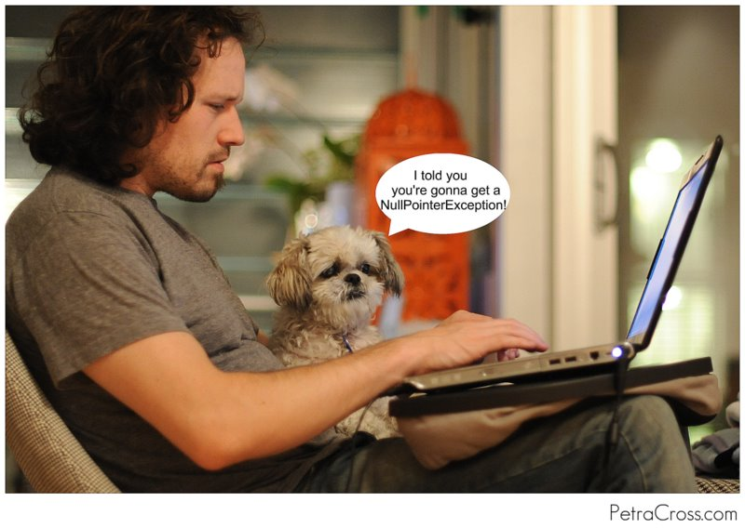
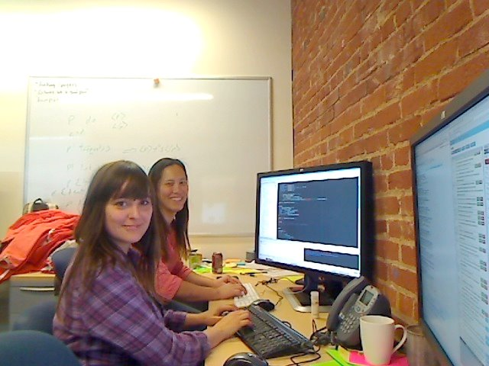
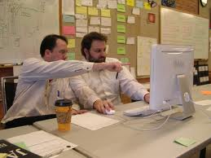
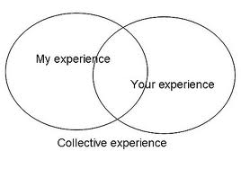
Pair-Programming (Key practice of XP)

Slide 82
XP (Extreme Programming)…….
XP Practices
Collective ownership - anyone can change any part of the code at any time.
Continuous integration - new builds as soon as code ready
40 hour week - maximum 40-hour week. No overtime
On-site customer - customer present and available full-time for team
Coding standards - rules exist and are followed
Open workspace - large room small cubicles
Just rules - team has own rules but can be changed any at time

Slide 83
Key Practices of XP…..
Planning
User stories are written.
Release planning creates the schedule.
Make frequent small releases
The Project Velocity is measured.
The project is divided into iterations.
Iteration planning starts each iteration.
Move people around.
A stand-up meeting starts each day.
Fix XP when it breaks.
Designing
Simplicity.
Choose a system metaphor. (system of names for your objects that everyone can relate to)
Use CRC cards for design sessions.
Create spike solutions to reduce risk.
Refactor whenever and wherever possible e.g. Techniques for improving names and location of code Move method or move field – move to a more appropriate class or source file
Rename method or rename field – changing the name into a new one that better reveals its purpose
Pull up – in object-oriented programming (OOP), move to a superclass
Push down – in OOP, move to a subclass[
Notes:
83
system metaphor
Choose a system metaphor to keep the team on the same page by naming classes and methods consistently. Choose a system of names for your objects that everyone can relate to without specific, hard to earn knowledge about the system. CRC: Class Responsibility collaborators ??
Refactor
When we remove redundancy, eliminate unused functionality, and renew obsolete designs we are refactoring. Refactoring throughout the entire project life cycle saves time and increases quality. Refactor mercilessly to keep the design simple as you go and to avoid needless clutter and complexity.
Example: Techniques for improving names and location of code Move method or move field – move to a more appropriate class or source file
Rename method or rename field – changing the name into a new one that better reveals its purpose
Pull up – in object-oriented programming (OOP), move to a superclass
Push down – in OOP, move to a subclass^{[7]}
A Class Responsibility Collaborator (CRC) model (Beck & Cunningham 1989; Wilkinson 1995; Ambler 1995) is a collection of standard index cards that have been divided into three sections, A class represents a collection of similar objects, a responsibility is something that a class knows or does, and a collaborator is another class that a class interacts with to fulfill its responsibilities. Figure 2 presents an example of two hand-drawn CRC cards.

Slide 84
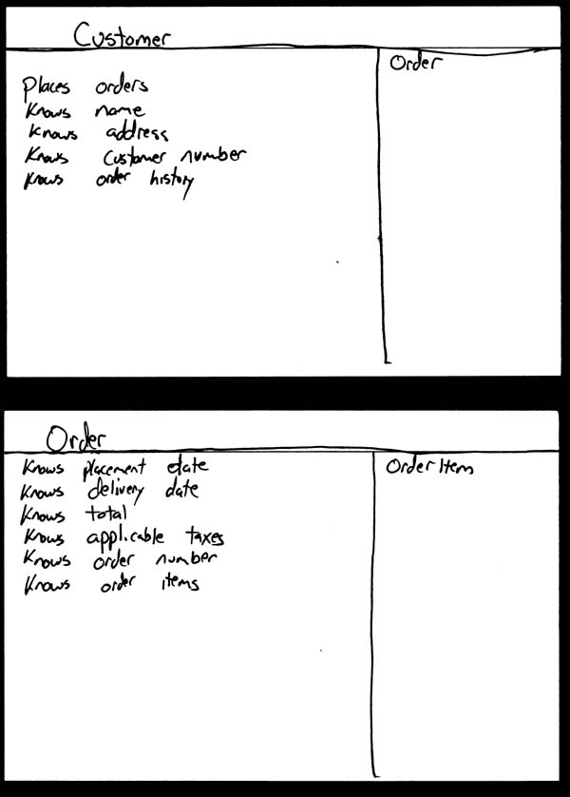
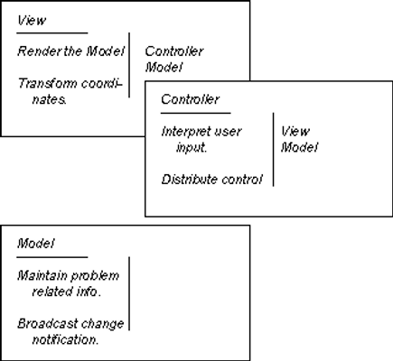
Notes:
CRC example

Slide 85
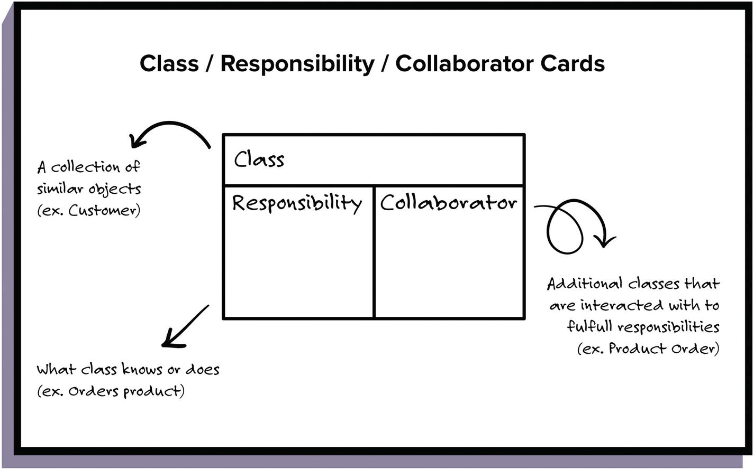

Slide 86
Key Practices…
Coding
The customer is always available.
Code must be written to agreed standards.
Code the unit test first.
All production code is pair programmed.
Only one pair integrates code at a time.
Integrate often.
No overtime.
Testing
All code must have unit tests.
All code must pass all unit tests before it can be released.
When a bug is found tests are created.
Acceptance tests are run often and the score is published.
Notes:
86
unit test first
When you create your tests first, before the code, you will find it much easier and faster to create your code. The combined time it takes to create a unit test and create some code to make it pass is about the same as just coding it up straight away. But, if you already have the unit tests you don't need to create them after the code saving you some time now and lots later.
- Use collective code ownership.
- Leave optimization till last.

Slide 87
XP > Practices > “Circles of Life”
On-site Customer
Coding Standards
Metaphor
Refactoring
Customer – Team – Developer Pair – Team – Customer
Acceptance Tests
Unit Tests
Pair Programming
Release Planning
Continuous Integration
Collective Ownership
Simple Design
Sustainable Pace
Synergy >
Small Releases
Notes:
87
Different Roles within the Extreme Programming methodology work with some of the practices more than others. This “Circle of Life” diagram (adapted from Ron Jefferies papers on XP) shows how the customer is more involved with the “outer ring” practices, the team is involved in all practices, and developers, or pairs of developers are involved in some of the “inner ring” practices.
Synergy >> meaning working together

Slide 88
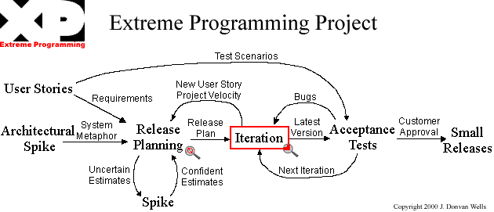
Fitting it all togather
Notes:
Spike: For example, a programmer might not know whether Java throws an exception on arithmetic overflow. A quick ten-minute spike will answer the question
Architectural spike are stage-prop demos or prototypes

Slide 89
XP – Advantages/ Disadvantages
Advantages
Built-In Quality
Overall Simplicity
Programmer Power
Customer Power
Synergy Between Practices
Disadvantages
Informal, little, or no documentation
Scalability
Contract Issues
Misconception on the cost of change
Tailoring
Notes:
, Summary of Advantages and Disadvantages

Slide 90
Application
Applicable
Highly uncertain environments
Internal projects
Joint ventures
Not Suitable / Applicable
Large, complex environments
Safety critical situations
Well understood requirements
Distant or unavailable customer
Notes:
Well understood Requirement: When the requirements are very well understood, we have no need of the extreame flexiblity offered by XP. Better to follow other approaches.

Slide 91
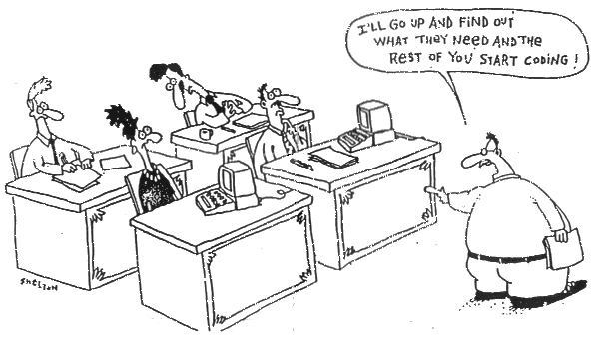
Final Thoughts
Why XP succeeds
Why XP is popular
Why XP fails
Why XP is not the “silver bullet”
How does XP practice of Pair Programming differ from Code Reviews? Which one is better?
Notes:
To be discussed: Perhaps a Question Answer style approach here would be better to see the understanding level of students.

Slide 92
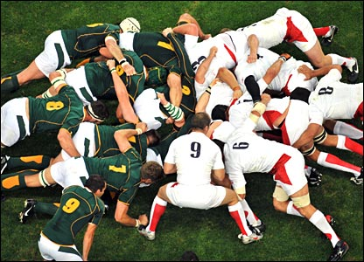
SCRUM

Slide 93
SCRUM
First presented to OMG in 1995 by shared concerns between Advanced Development Methods (ADM) and VMARK Software (VMARK).
ADM produces process automation software
VMARK produces object-oriented software development environments
Both companies were concerned over the lack of breakthrough productivity being reported in object-oriented development projects
Not an acronym, Rugby team uses SCRUM meetings
“A scrum is a team pack in Rugby, everybody in the pack acts together with everyone else to move the ball down the field”
Notes:
93
SCRUM is not an acronym (short form) of anything, but team pack in Rugby.

Slide 94
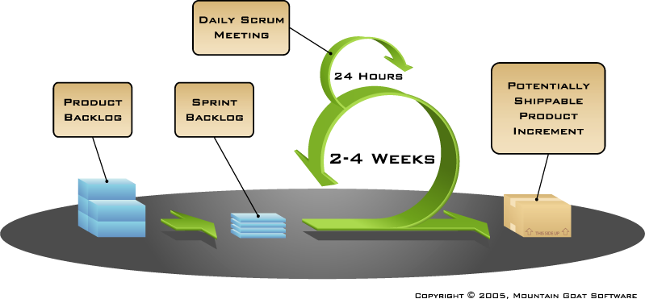
Putting it all together

Slide 95
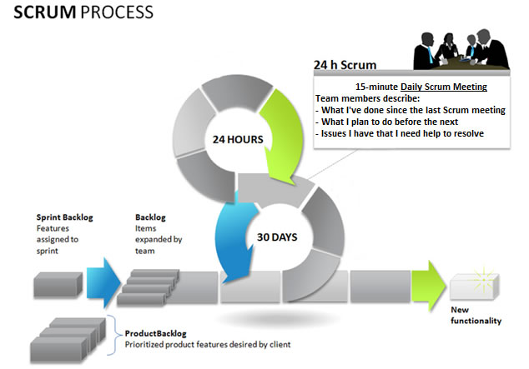
Putting it all together

Slide 96
The Philosophy of SCRUM
The core of the Scrum approach is the belief that most systems development has the wrong philosophical basis.
The stated, accepted philosophy is that systems development process is a well understood approach that can be planned, estimated, and successfully completed.
Scrum defines the systems development process as a loose set of activities that combines known, workable tools and techniques with the best that a development team can devise to build systems

Slide 97
What is SCRUM ?
Scrum is an agile, lightweight process to manage and control development work.
Scrum is a wrapper for existing engineering practices.
Scrum is a team-based approach to iteratively, incrementally develop systems and products when requirements are rapidly changing
Scrum is a process that controls the chaos of conflicting interests and needs.

Slide 98
What is SCRUM ?
Scrum is a way to improve communications and maximize co-operation.
Scrum is a way to detect and cause the removal of anything that gets in the way of developing and delivering products.
Scrum is a way to maximize productivity.
Scrum is scalable from single projects to entire organizations.

Slide 99
What is SCRUM ?
Scrum has controlled and organized development and implementation for multiple interrelated products and projects with over a thousand developers and implementers.
Scrum is a pattern.

Slide 100
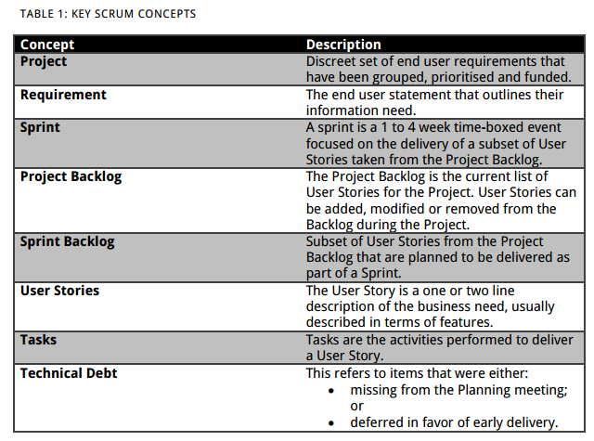

Slide 101
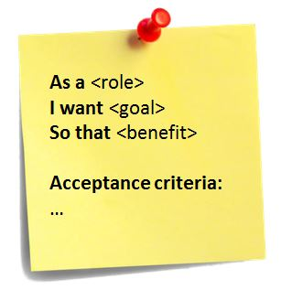
User Story Examples
Standard template of a US:
As a < type of user >,
I want < some goal >
so that < some reason >.
Ex1: As a power user, I can specify files or folders to backup based on file size, date created and date modified.
Ex2: As a user, I can indicate folders not to backup so that my backup drive isn't filled up with things I don't need saved.

Slide 102
How is detail added to user stories?
Detail can be added to user stories in two ways:
By splitting a user story into multiple, smaller user stories.
By adding “conditions of satisfaction.”
Ex1: As a vice president of marketing, I want to select a holiday season to be used when reviewing the performance of past advertising campaigns so that I can identify profitable ones.
Detail could be added as:
Make sure it works with major retail holidays: Christmas, Easter, President’s Day, Mother’s Day, Father’s Day.
Holiday seasons can be set from one holiday to the next (such as Thanksgiving to Christmas).
Holiday seasons can be set to be a number of days prior to the holiday.

Slide 103
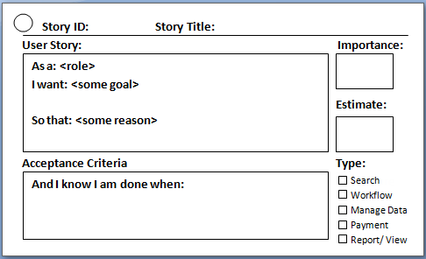
Notes:
User story Card

Slide 104
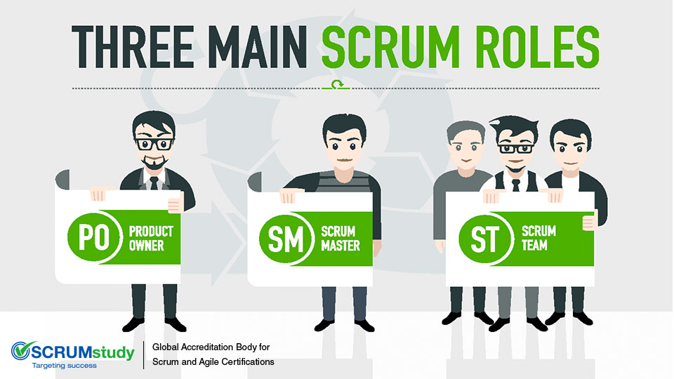
Notes:
The most important Roles in Scrum

Slide 105
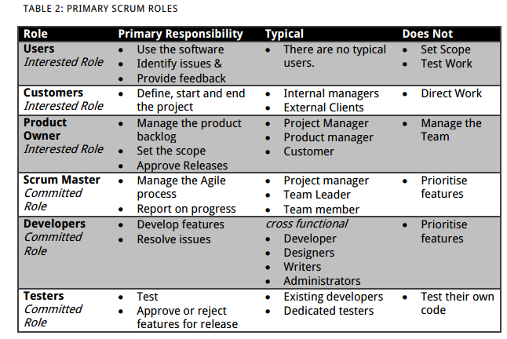

Slide 106
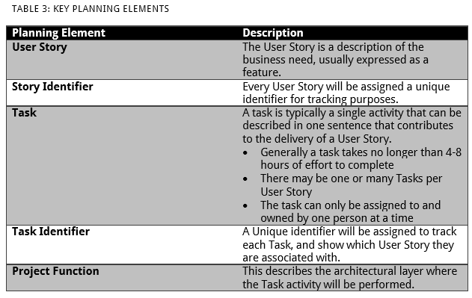

Slide 107
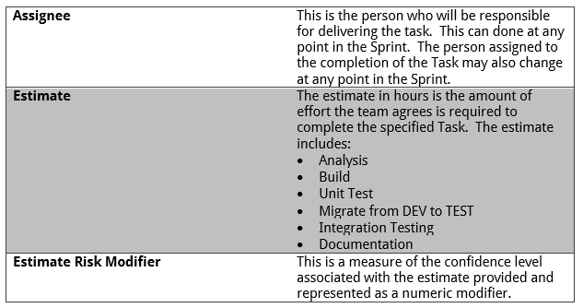

Slide 108

Scrum framework
Roles
Product owner
ScrumMaster
Team
Ceremonies
Sprint planning
Sprint review
Sprint retrospective
Daily scrum meeting
Artifacts
Product backlog
Sprint backlog
Burndown charts
Notes:
Retrospective : only within the team
Review: with the stakeholder

Slide 109
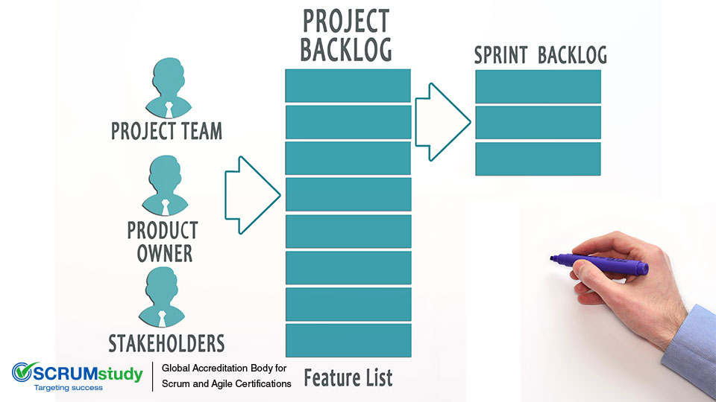

Slide 110
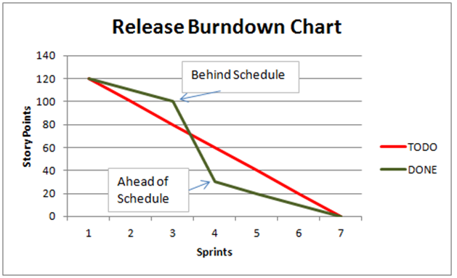
Example of Scrum Artefacts:
Notes:
Product burn down chart

Slide 111
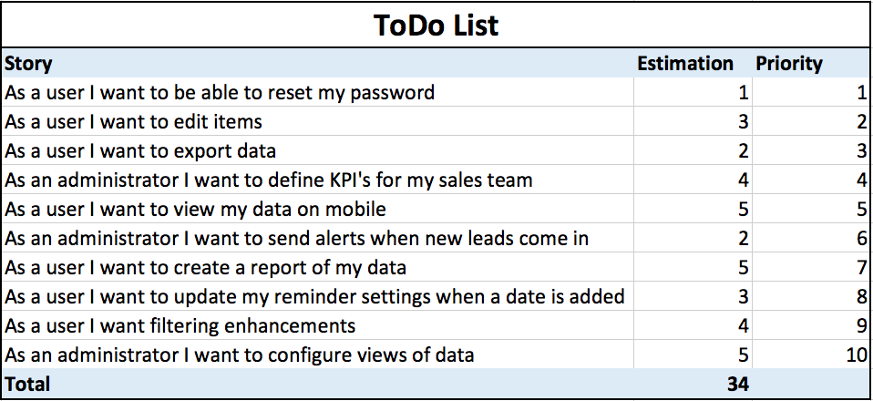
A sample product backlog

Slide 112
Scrum Artefacts: A sprint backlog
Tasks
Mon
Tues
Wed
Thur
Fri
Code the user interface
8
4
8
Code the middle tier
16
12
10
4
Test the middle tier
8
16
16
11
8
Write online help
12
Write the foo class
8
8
8
8
8
Add error logging
8
4

Slide 113

Product owner
Define the features of the product
Decide on release date and content
Be responsible for the profitability of the product (ROI)
Prioritize features according to market value
Adjust features and priority every iteration, as needed
Accept or reject work results

Slide 114

The ScrumMaster
Represents management to the project
Responsible for enacting Scrum values and practices
Removes impediments
Ensure that the team is fully functional and productive
Enable close cooperation across all roles and functions
Shield the team from external interferences

Slide 115





The team
Typically 5-9 people
Cross-functional:
Programmers, testers, user experience designers, etc.
Members should be full-time
May be exceptions (e.g., database administrator)

Slide 116
The team
Teams are self-organizing
Ideally, no titles but rarely a possibility
Membership should change only between sprints

Slide 117
How Does Scrum Work?
Small teams (< 10 people)
A series of Sprints (1 - 4 weeks)
Visible, usable increments
Time-boxed
Notes:
117
sprint >> pursuit >>

Slide 118
Sprint Rules
Total focus—no unwanted diversion
NO interruptions/changes from the outside
New work may be uncovered by the team
Very XP-ish
Notes:
118

Slide 119
What Happens During a Sprint?
Frequent, short Scrum Meetings
Each team produces a visible, usable increment
Each increment builds on prior increments
Clearly defined deliverables and responsibilities
Each team member buys into the assignment
Benefits
Notes:
119

Slide 120


No changes during a sprint
Change
Plan sprint durations around how long you can commit to keeping change out of the sprint
Notes:
Added by Dr. Uzair

Slide 121
The daily scrum
Parameters
Daily
15-minutes
Stand-up
Not for problem solving
Whole world is invited
Only team members, ScrumMaster, product owner, can talk
Helps avoid other unnecessary meetings

Slide 122


Everyone answers 3 questions?
1
What did you do yesterday?
2
What will you do today?
3
Is anything in your way?
These are not status for the ScrumMaster
They are commitments in front of peers

Slide 123
At the End of a Sprint?
Status meeting with all stakeholders.
Increments are delivered.
Surprises are reported.
ANYTHING can be changed, work can be added, eliminated, re-prioritized.
New estimates and team assignments are made for the next Sprint.
The project can be cancelled.
“Experience from earlier increments allows better estimates and planning as project progresses. It's always easier to estimate shorter development periods”
Notes:
123

Slide 124
The sprint review
Team presents what it accomplished during the sprint
Typically takes the form of a demo of new features or underlying architecture
Informal
2-hour prep time rule
No slides
Whole team participates
Invite the world

Slide 125
Sprint retrospective
Periodically take a look at what is and is not working
Typically 15–30 minutes
Done after every sprint
Whole team participates
ScrumMaster
Product owner
Team
Possibly customers and others

Slide 126
Sequential vs. overlapping development
Requirements
Design
Code
Test
Rather than doing all of one thing at a time...
...Scrum teams do a little of everything all the time
Source: “The New New Product Development Game” by Takeuchi and Nonaka. Harvard Business Review, January 1986.

Slide 127
Scalability
Typical individual team is 7 ± 2 people
Scalability comes from teams of teams
Factors in scaling
Type of application
Team size
Team dispersion
Project duration
Scrum has been used on multiple 500+ person projects

Slide 128






Scaling through the Scrum of scrums
Notes:
Added by Dr. Uzair

Slide 129
Scrum of scrums of scrums

Slide 130
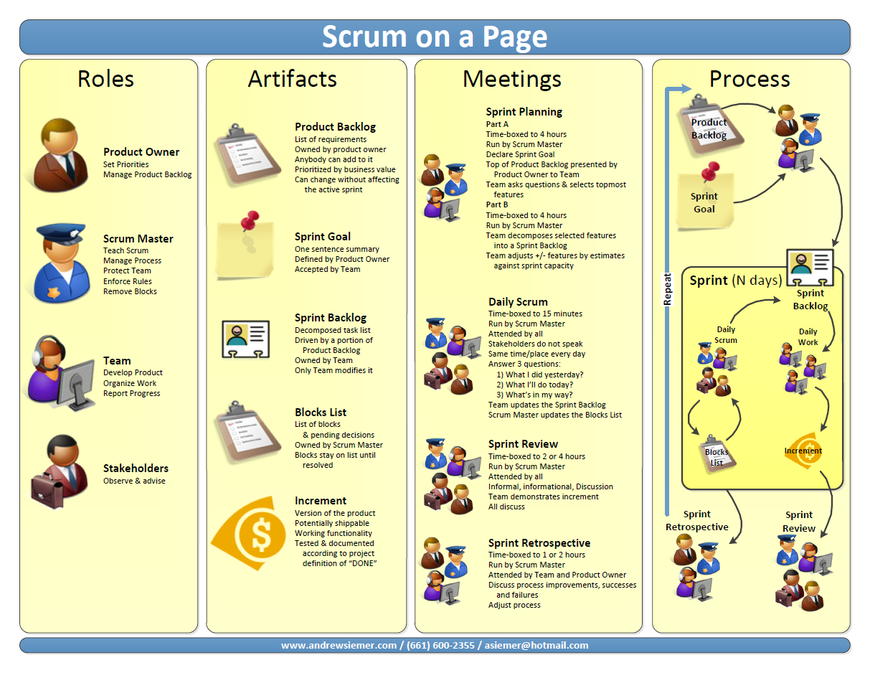

Slide 131





Scrum has been used by:
Microsoft
Yahoo
Google
Electronic Arts
High Moon Studios
Lockheed Martin
Philips
Siemens
Nokia
Capital One
BBC
Intuit
Intuit
Nielsen Media
First American Real Estate
BMC Software
Ipswitch
John Deere
Lexis Nexis
Sabre
Salesforce.com
Time Warner
Turner Broadcasting
Oce
Notes:
Some of the biggest companies in the world use SCRUM

Slide 132
Scrum has been used for:
Commercial software
In-house development
Contract development
Fixed-price projects
Financial applications
ISO 9001-certified applications
Embedded systems
24x7 systems with 99.999% uptime requirements
the Joint Strike Fighter
Video game development
FDA-approved, life-critical systems
Satellite-control software
Websites
Handheld software
Mobile phones
Network switching applications
ISV applications
Some of the largest applications in use
Notes:
F-35 Lighting II (The most expensive fighter aircraft in history)

